Slide 1

Making a BANK CUSTOMER CHURN model
USING PYTHON

Slide 2
DEFINING THE PROBLEM:
This is a classification or logistic regression model with the a number of independent variables being categorical.
We use the independent variables which are the factors on which it depends whether a customer will exit the bank or not. This is shown in the “Churn” column.

Slide 3
Details about the variables:
“CustomerId” is the unique key
“Churn” is the dependent variable (y)
“CreditScore”, “Gender”, “Geography”, “Age”, “Tenure”, “Balance”, “Num Of Products”, “Has Credit”, “Is Active Member” and “Estimated Salary” are together taken as the independent variables (X)
“Surname” column is dropped.

Slide 4
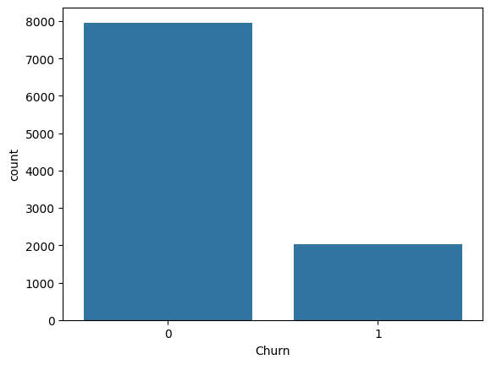
A histogram of the total number of people who left (churn=1) and those who remained (churn=0) using the count() function plotted.
OBSERVATION: Imbalance in data; data not sufficient.
Visual representation of the original data.

Slide 5
To deal with the imbalance in data two methods are used:
Random Under Sampling (RUS)
Random Over Sampling (ROS)

Slide 6
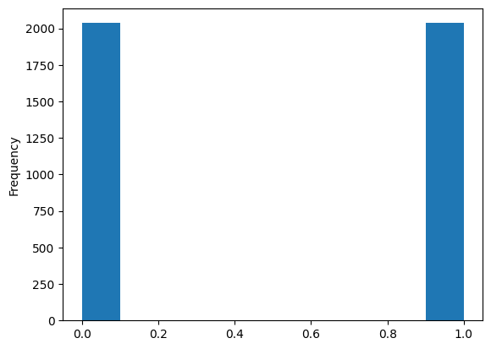
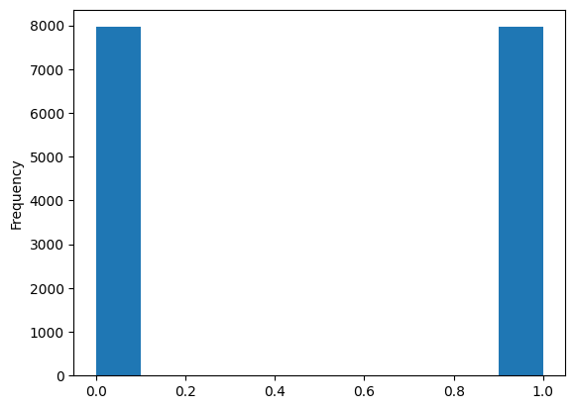
Visual representation of the data after RUS
y_rus.plot(kind="hist")
Visual representation of the data after ROS
y_ros.plot(kind="hist")

Slide 7
Z-SCORE Normalization
After splitting into train and test, the features are standardized to make their scale uniform.
This technique rescales data to have a null mean and unitary variance.

Slide 8
SUPPORT VECTOR MACHINE CLASSIFIER
SVMs are used to classify data into groups by finding a hyperplane that separates the data classes. SVMs are particularly effective at binary classification problems, which involve separating data into two groups

Slide 9
RESULT:
On using SVM on the original dataset we get an accuracy of 84% BUT the recall value is 25% which is very low.
Thus, we use the SVM again of the RUS and ROS data to find that the recall value has increased to 75% in both of them.

Slide 10
Index of Python libraries used:
Pandas
Numpy
Matplotlib.pyplot
Seaborn
Imblearn
Scikit

Slide 11
THANK YOU!

